Slide 1
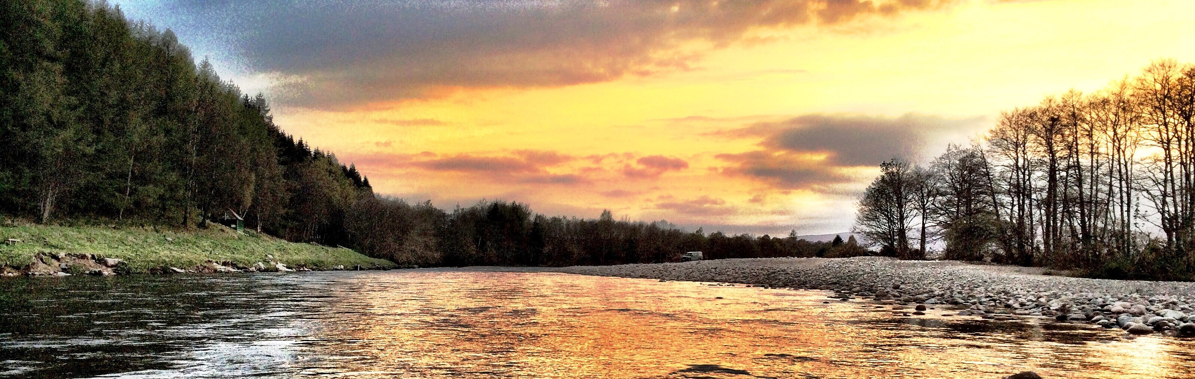
ADAA AGM January 2019
Lorraine Hawkins, Edwin Third
Fisheries management on the Dee and Don
Notes:
I’ll be covering 2 topics – stocks, and smolt tracking
Hard not to speak about stocks without graphs, so apologies I have got a few graphs initially
The Dee Board manages the Don on behalf of the Don Board, so Ed and I will be talking about both rivers.
The Don Board delivers work for the Ythan Board through an annual contract, but that will not be presented here.

Slide 2
Annual catches of salmon - Dee
Notes:
2018: just over 3300 fish caught.- fish Dee. Which is actually a lot better than where we thought we’d end up, but we have had a good month of catches.
Just over 4000 fish in 2017.
As you can see from the graph, we’re in a period of low catches that started in 2014. This low period has been across Scotland – lowest catches nationally in the 65 year time period.

Slide 3
Annual catches of salmon - Don
Conservation of Salmon (Scotland) Regulations 2016
Category 3 – exploitation is unsustainable; C&R mandatory
Notes:
Catch returns have not yet been received for the 2018 season, it is expected to be improved on 2016/17 but still at a very low level.
2017 – 276 salmon, C&R – 93%
During 2018, low river levels likely reduced the catches, despite evidence from the early season that there were fish in the river.
Salmon rod catches have declined substantially since 2013, with the last five years averaging 600 fish. Prior to this, the 10-year average rod catch was nearly 2000 salmon.
As everyone is probably aware, SG’s Conservation of Salmon Regulations require all significant river systems to have an annual assessment of their salmon stocks.
Each river is categorised as 1,2,3., reflecting whether the current level of exploitation is considered sustainable or not. Cat 1 is that exploitation is sustainable and no changes to management are required. Cat 3 is that exploitation is unsustainable. The Don has been cat 2 for a couple of years previously, but last year was moved into category 3. It was confirmed in October that the Don would remain cat 3 next year. This meant the C&R became mandatory throughout the season.

Slide 4
Annual catches of sea trout
Dee
Don
920 in 2018; FishDee
Notes:
2017 – 1424 sea trout caught. Above the 5 year average. – 1171 - although catches not outstanding for the last 5 years. But no decline.
DON: In 2018, sea trout catches have remained low, but likely better than the previous two years, although catch returns to confirm this have still to be received.
144 sea trout, 90% C&R
The 5-year average catch is 176.

Slide 5
Juvenile salmon stocks - Dee
Notes:
EF is used to assess juvenile stock health.
Last year, we worked with MSS as part of a national programme of stock assessment. However, the results of this assessment are not available yet. This will feed into the Conservation Regulations in the future.
Therefore we have done a simple assessment of some of our repeat sites – all in the upper catchment, west of Ballater
Fry: low of 3, to high of 28 per 100m2
Parr: 8 to 22 per 100m2
Partial influence of low river in summer 2018 – less area to occupy

Slide 6
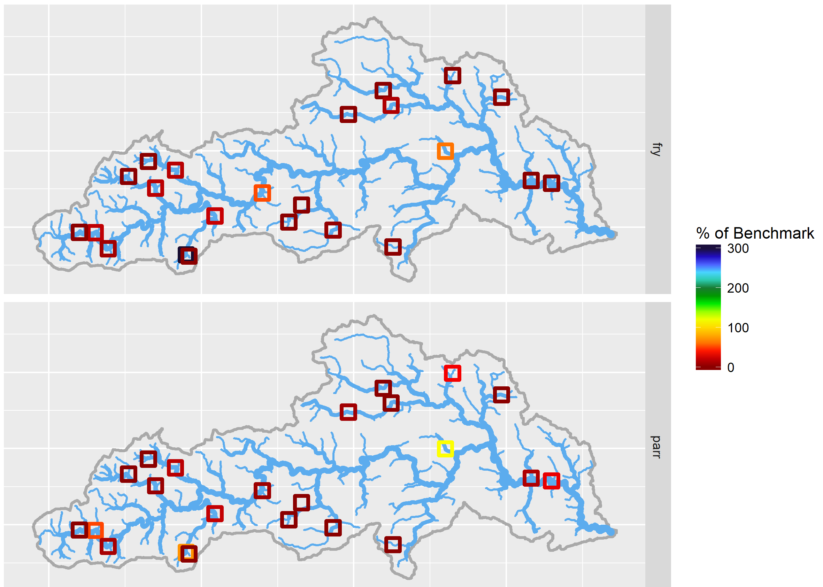
Juvenile salmon stocks - Don
Notes:
The 2018 data is currently being analysed by MSS and no results available as yet.
So this picture shows results of the 2017 surveys – based on estimates of fry and parr densities. The assessment compares these densities of salmon fry and parr with the density levels that would be expected (i.e. a benchmark) if the salmon stock was in good health. The benchmark is specific to each site surveyed, as it is based on site-specific characteristics such as altitude and upstream catchment area.
Values yellow or above on the spectrum indicate that fish densities exceeded or were in line with expectation.
Overall, fry and parr densities are below the expected densities. Many sites without salmon, especially fry.

Slide 7
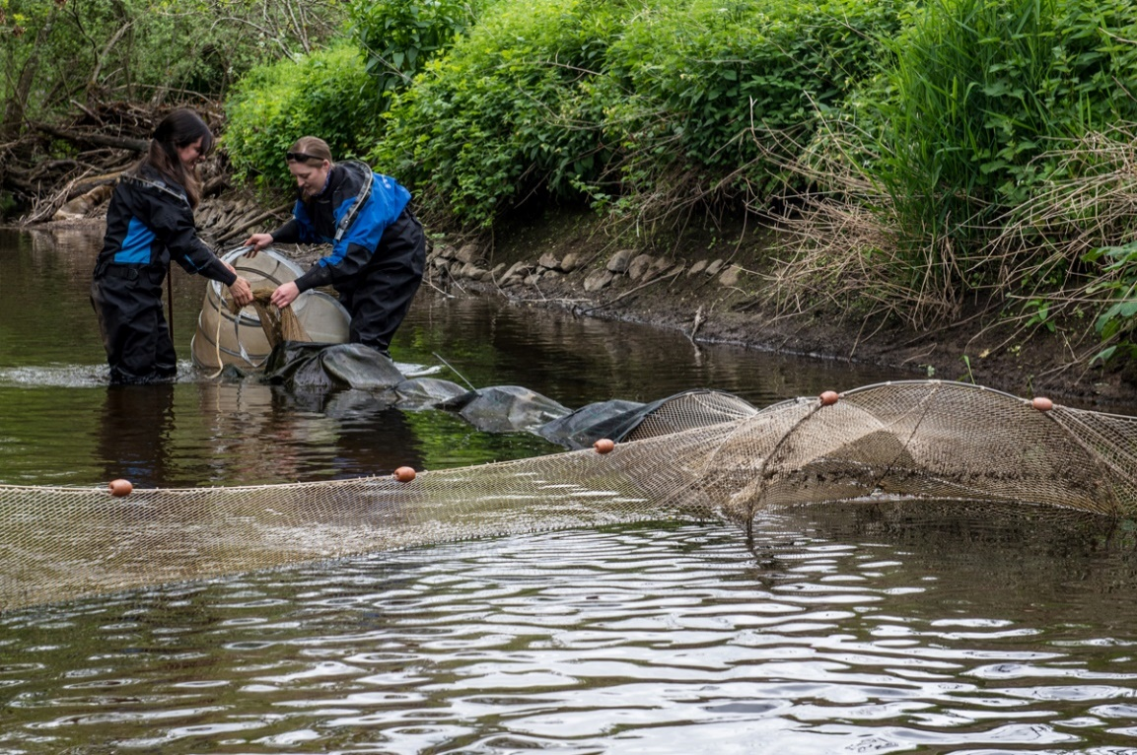
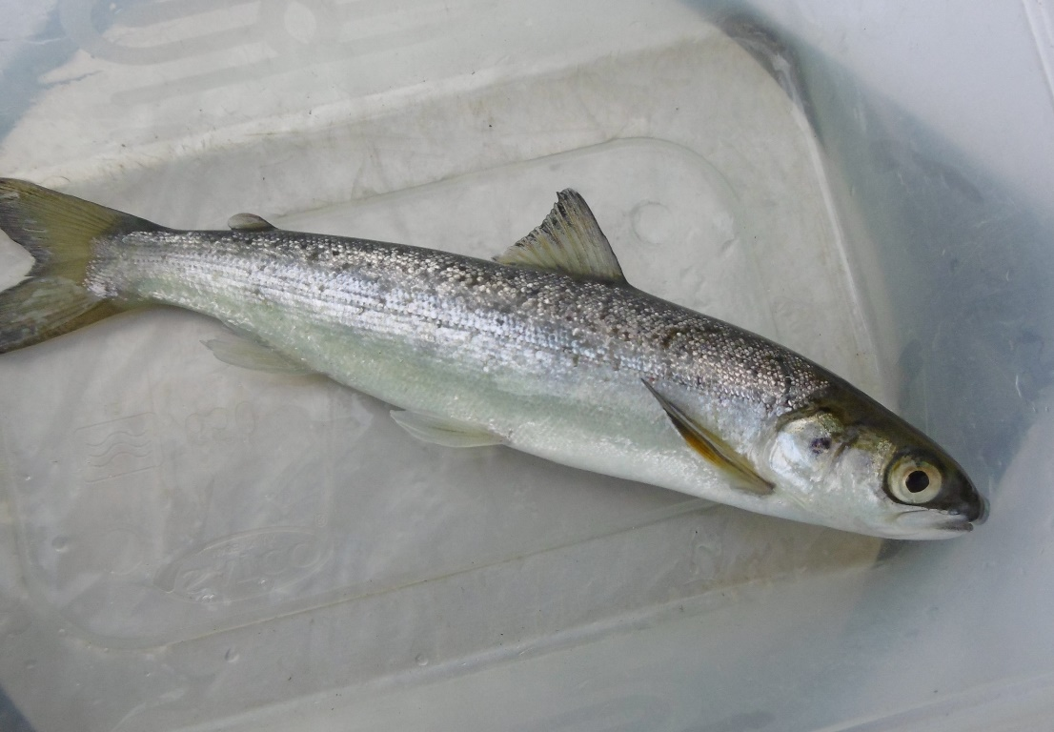
Smolt production
Notes:
For the last 3 years we’ve been running Smolt traps on 2 tributaries of the Dee.
Numbers of smolts were disappointing – beltie was only 50% of last years captures for salmon, and sheeoch numbers were 30% down on 2017.
An adult fish counter on beltie suggests low smolt production in 2018 not due to particularly low adult returns. Instead, expect it is the impact of Storm Frank.
The purpose of the smolt traps is long-term monitoring of smolt production from the lower catchment, as smolts are our ultimate product from the river. However, as the smolt tracking work is demonstrating, the number of smolts the Dee produces is not the end of the story, as it has become apparent that there is no guarantee that these smolts will make it to sea.

Slide 8
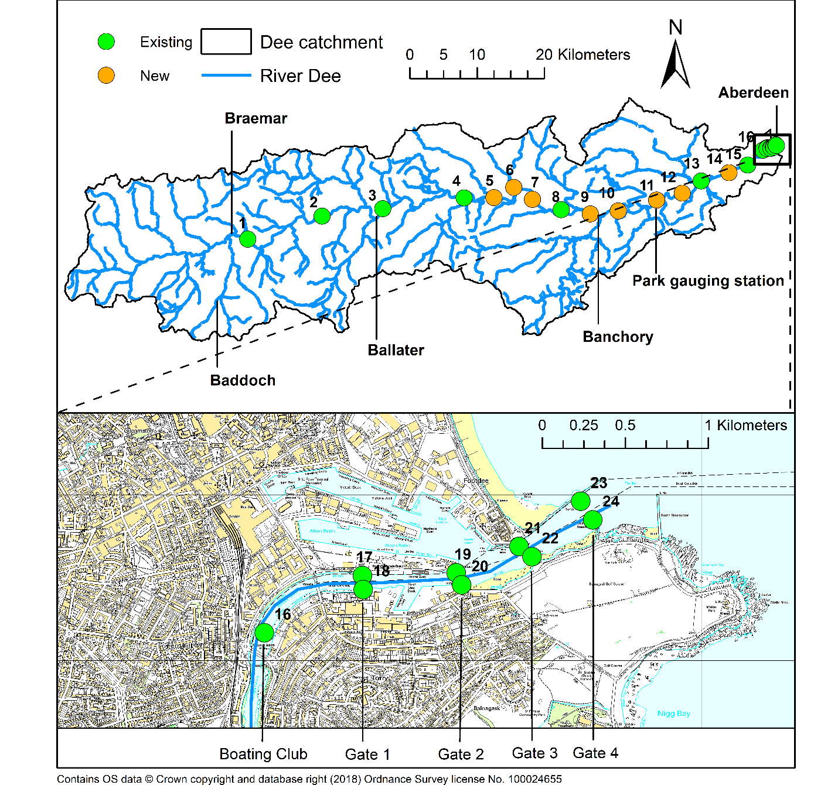
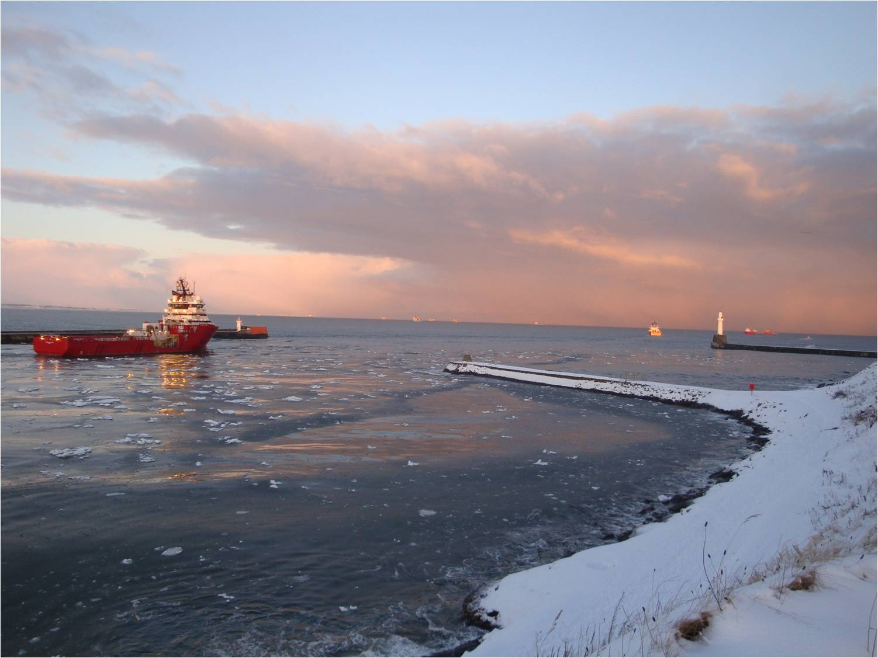
Smolt tracking
Notes:
We have been tracking smolts migrating through the Dee and harbour for the last 3 years, funded by the Dee DSFB.
The last 2 years, we’ve tagged smolts in the upper Dee and tracked them for their 75 mile journey to the Old South breakwater. We tracked them by placing receivers in the river/harbour – these receivers detected tagged fish and recorded the time/date the fish were detected.
In 2017 we found most smolt mortality in the upper/middle catchment, suspected to be due to goosander predation. So we planned the 2018 tracking to look at in-river losses in greater depth – placing receivers in the river, and in the harbour – Maps.

Slide 9
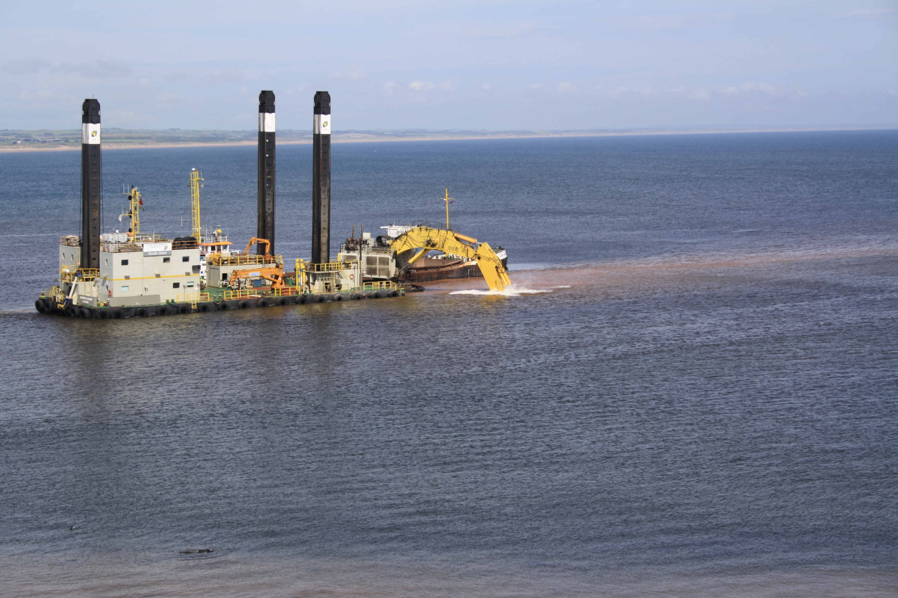
2018 in-river tracking
100 smolts tagged in April
21% mortality in the river – 73 miles
28% mortality in the harbour – 1.5 miles
Total: 49% mortality
In harbour: 17 April – 15 May
Coincided with annual harbour dredging
Notes:
River mortality much lower than in 2017
In 2017 mortality mainly in river, in 2018 mortality in harbour. In both years, nearly half of smolts did not survive to get to sea.

Slide 10
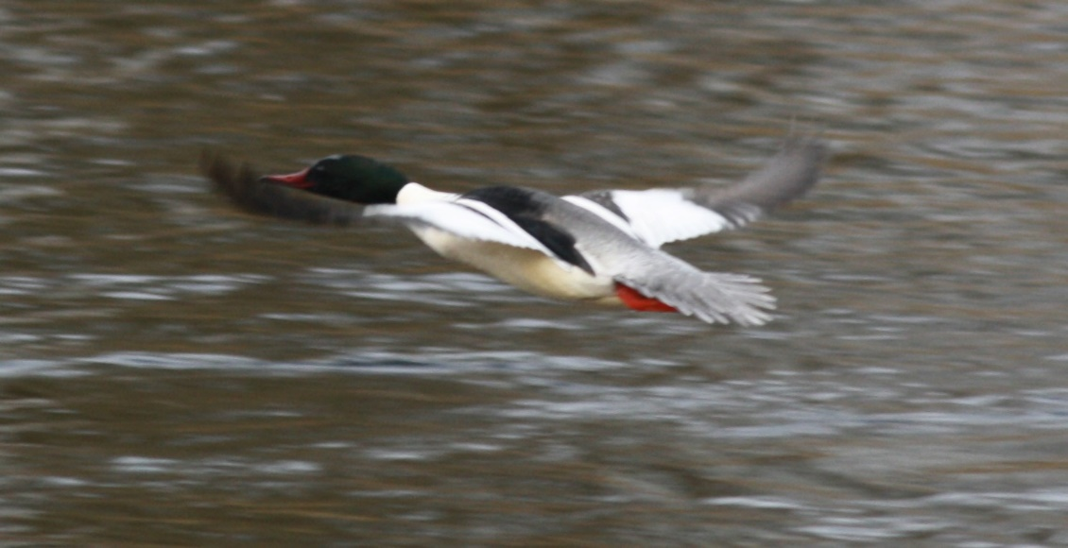
2019 in-river tracking
Does goosander removal improve smolt survival?
140 tagged smolts
2 exclusion zones + 2 control zones, 5 km each
Determine smolt survival in each zone
Stomach content analyses

Slide 11
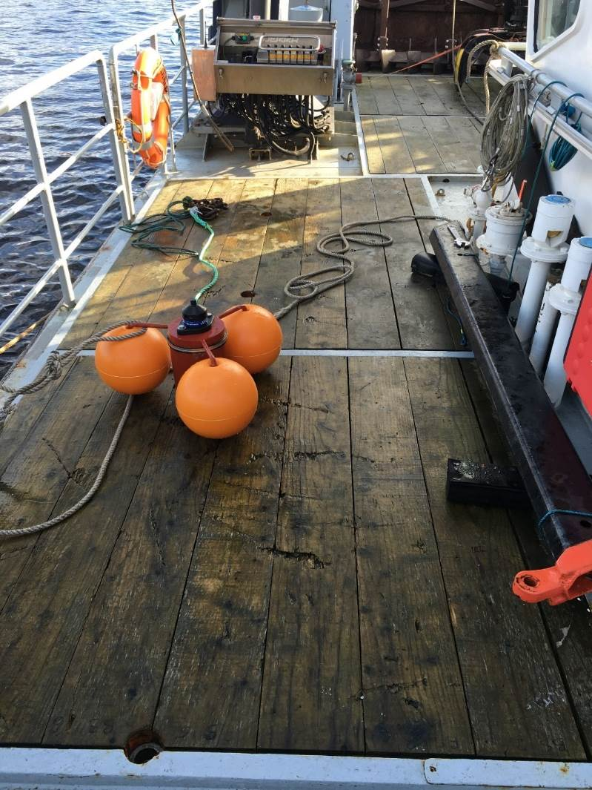
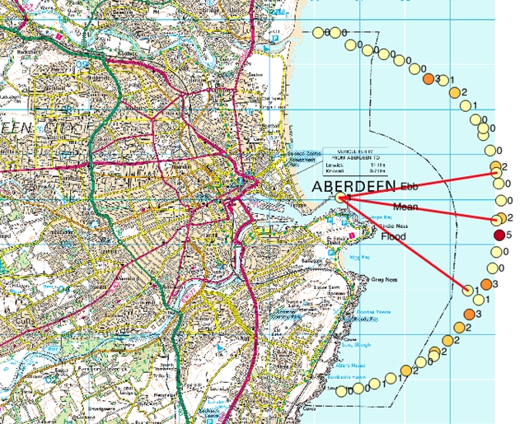
North East tracking
Trust and MSS joint project – salmon and sea trout tracking at sea
Funded by Aberdeen Bay Wind Farm Ltd
2017
Notes:
The second tracking study is in conjunction with MSS and funded by MSS and the developers of the Aberdeen bay offshore wind farm. This work is to track smolts at sea and is a £1 million project over the next 3 years.
The purpose of this is so we can identify and protect the areas of the important migratory routes. Particularly w.r.t. offshore developments.
2017: MSS study showed that most smolts headed SSE as they left the Dee, at 4 km from the harbour

Slide 12
North East tracking
2018: 100 salmon smolts and 50 sea trout smolts
Detection arrays 4 km and 10 km from harbour – 144 receivers
2019: 150 salmon smolts – Dee and Don
Notes:
This year we have tagged 100 salmon smolts and 50 sea trout smolts. And deployed over 140 receivers in the sea.
The tracking at sea involves 2 arrays of receivers, one at 4km and one at 10 km from the harbour.
This will show us the direction at which smolts leave the river and will enable us to plan deployment of receivers in 2019, so we can follow their migration route further.
We have only just got the receivers in, and will be analysing results over the next couple of months.

Slide 13

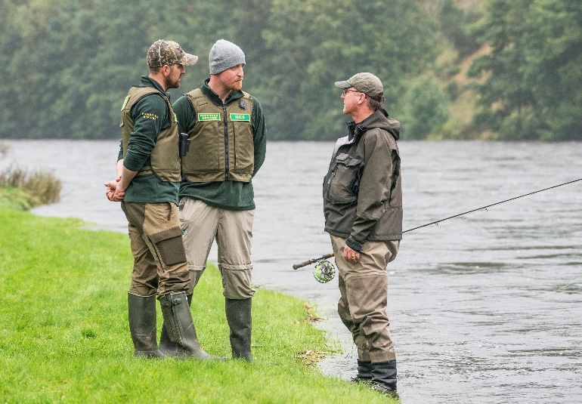
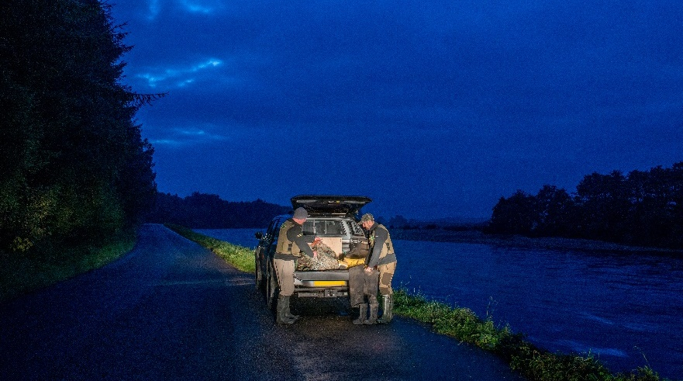
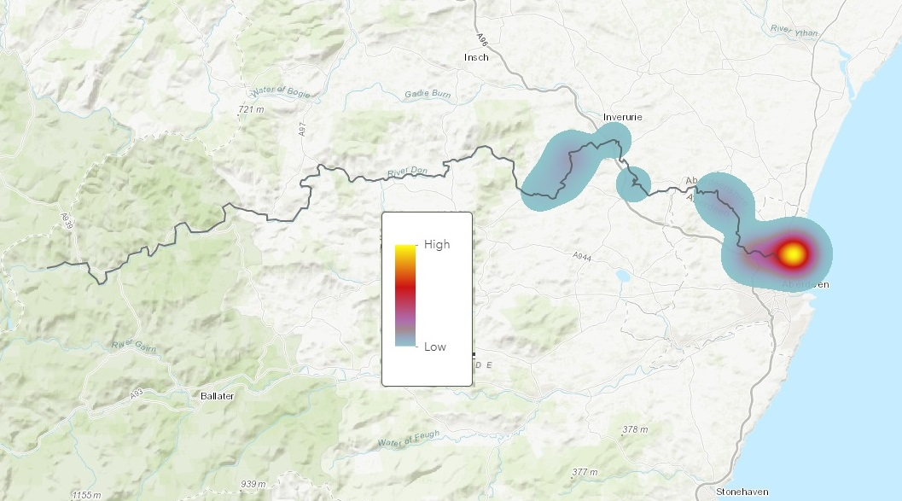

Protecting the Fishery
Policing
> 80 poaching incidents Dee/Don/Ythan
Dee & Don staff working together
Sharing intelligence through operation ‘Salmo’
Increasing use of technology
24 hr number for poaching - 013398 80411
01467 642121
Notes:
Policing activity
Effective enforcement of fishery legislation is vital for the future of salmon stocks and the Deeside economy.
31 incidents for 2018, above 5 year average but similar to 2017 season - even with river conditions and the World Cup during July its high (suggesting more effective policing).
Mainly rod and line poaching with the exception of a single netting event at the very start of the season. This was out with historical patterns for netting gangs and night patrols were subsequently undertaken alongside the development of operation Salmo with Police Scotland.
Operation ‘Salmo’ joint operation – one key element was utilising police intelligence relating to movement of know poaching gangs using ANPR technology coupled with other intel led to several joint patrols. Whilst the patrols did not result in arrests this ongoing operation has continued to encourage sharing of intelligence between Police Scotland and the Board.
Dee & Don bailiffs have been working closely – Benefitted the Board in terms of increased coverage across the catchment at peak policing times, extended the scale and coverage of policing throughout any given day and allowed for sustained policing during annual leave. Creating more effective/efficient policing resulting in more poachers caught.
Increasing our use of advances in technology - thermal imaging, trail cameras, communication with neighbouring boards, police intelligence
The Bailiffs have asked me to thank all ghillies, anglers and proprietors for their support
I’d also like to remind everyone to contact the 24hr number if there are any concerns relating to poaching.

Slide 14
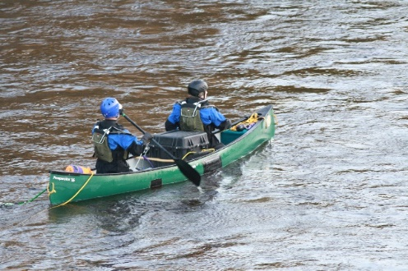
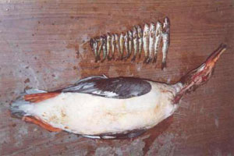
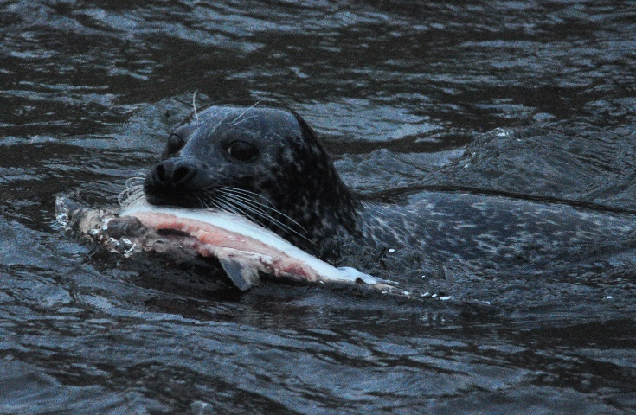
Protecting the Fishery
Predator Management
7 bird counts, Sept – May
Canoe counts, Dee/Don/Ythan
SNH licence – Shoot Goosanders Cormorants as aid to scaring.
Increased area counted
Successful extension to control period Sept – May
Over 70 marksmen appointed for bird licence
Notes:
Predator Management
The Don DSFB undertook 9 walkover surveys each month from Sept to May to count goosanders, mergansers and cormorants on the main stem from the Poldullie by Strathdon down to the estuary, approximately 90 km.
On average 92 goosanders and 7 cormorants were recorded each month.
The walkover survey data supports our application for a licence to Scottish Natural Heritage (SNH) to control fish-eating birds. The licence granted by SNH allows for named volunteer marksmen authorised to ‘shoot to scare’ and control a target number of birds. The licence normally covers March to Mid-May and during 2018 the Don DSFB licensed 19 volunteer marksmen to control 16 goosanders and 2 cormorants.
This year we also successfully argued to extend the control period from September to mid-May for the 2018-2019 season, to ensure maximum protection for juvenile salmonids during the autumn months when bird numbers are at their highest on the river (15 & 3).
The Don Fisheries Officers have also undergone training to allow them to survey the river by canoe. Experience from the River Dee illustrates that canoe surveys provide a higher average bird count than walkover surveys. Where conditions and situations permit, surveys during the 2018-19 season will take place by canoe.
The Don DSFB would like to thank all the volunteer marksmen who help with this programme to control these highly effective predators of fish on the river.
Seals recorded by staff and anglers.
Staff have responded to seal activity when in proximity of sighting and try to displace seal downstream using non-lethal methods.
I’d also like to remind everyone to contact the 24hr number if there are any concerns relating to predators.

Slide 15
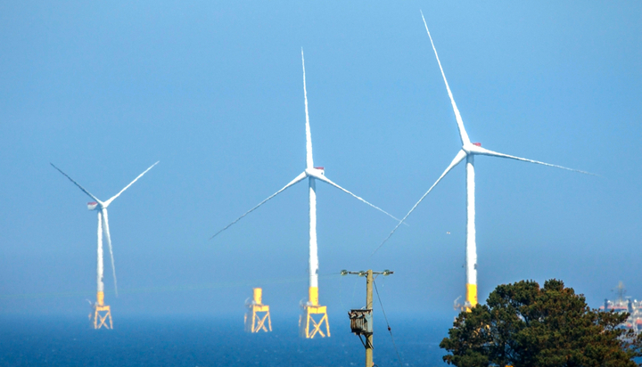
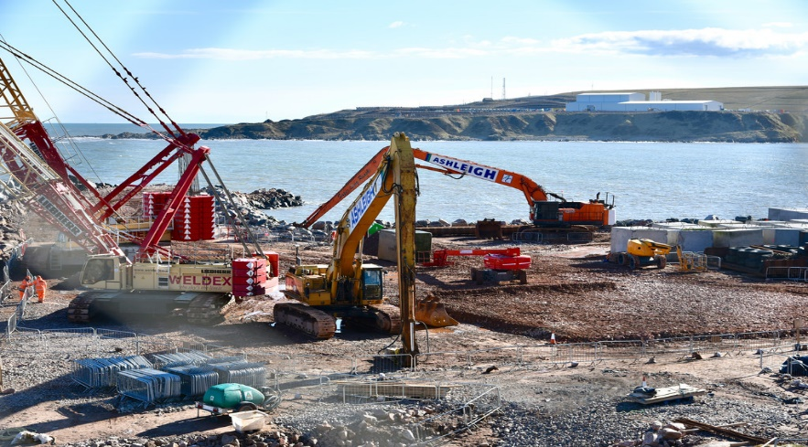
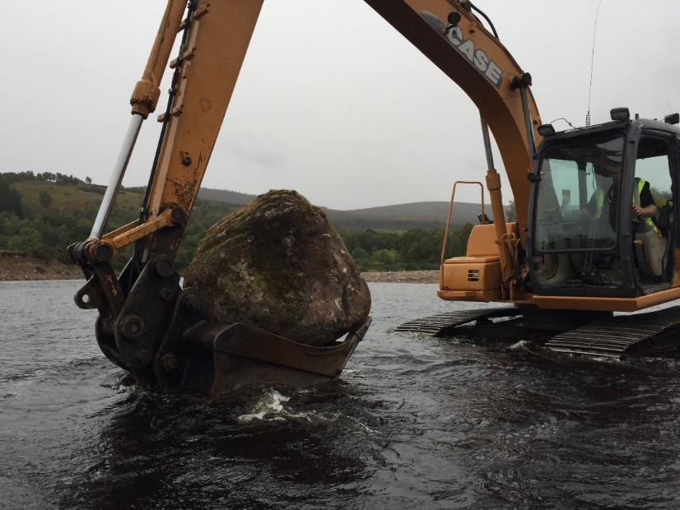
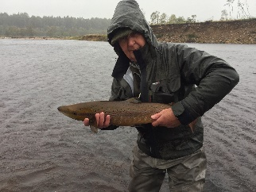
Development Response
SEPA Pollution Hotline 0800 80 70 60
Board 24hrs 01467 642121/013398 80411
74 developments assessed, from large projects to bridge repairs
Issues - blocking migration, degrading habitat and water quality
Aim is to reduce impacts to salmon
25 pollution incidents reported to SEPA
Somethings can have a positive impact!

Slide 16
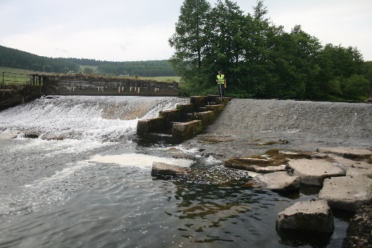
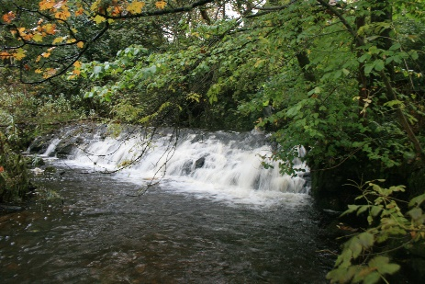
Obstacles to fish Migration
65 recorded man made obstacles.
20% of Don catchment has limited access to fish.
Priorities: Newe, Tullynessle and Montgarrie.
Also progressing with Williamston, Goval, Pit stop.
Issues: Ownership, design, flood risk, funding.

Slide 17
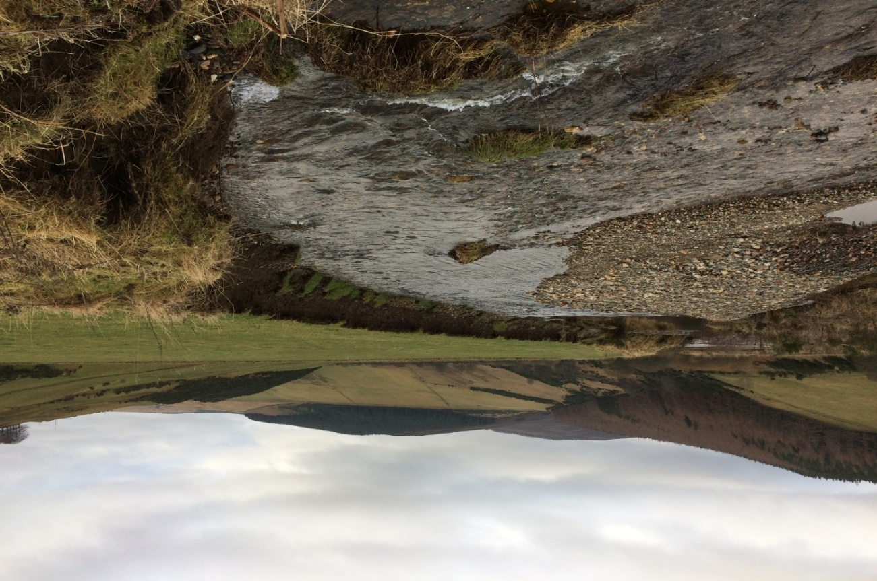
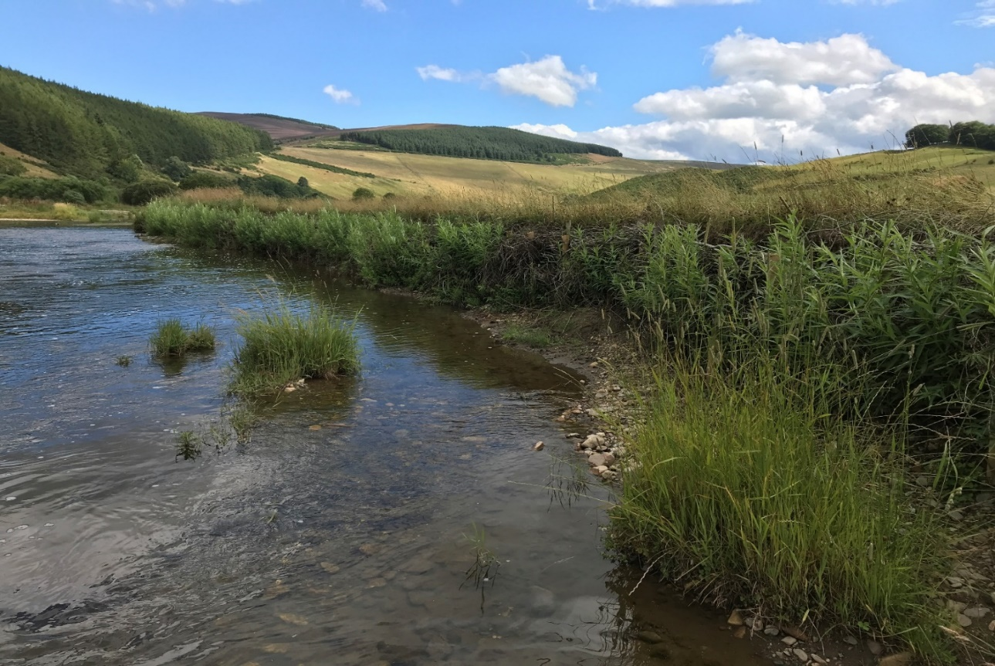
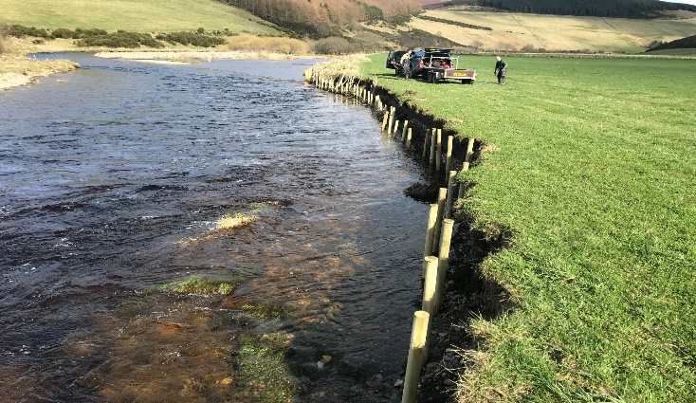
River Bank Restoration
Over 340m of bank restoration in 2018.
Use of willow to stabilise bank, provide cover and shade.
Brux – work carried out by Board staff.
Low cost. Simple authorisation process.
Volunteers always welcome!

Slide 18
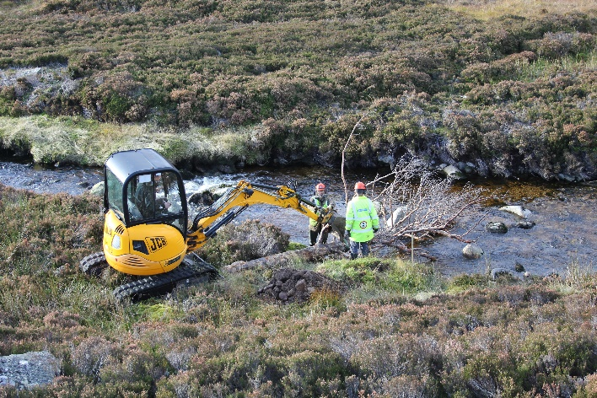
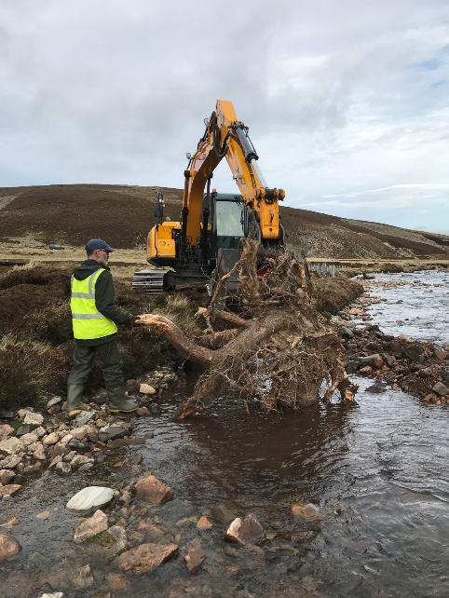
Habitat Restoration – Large Woody Structures
Restoration of instream habitat complexity.
LWS create cover from predators, deep cool pools,
help create spawning sites and trap nutrient.
Created LWS on Gelder, Cowie and Gairn.
Designed and anchored properly.
Many upland streams lack deep pools.

Slide 19
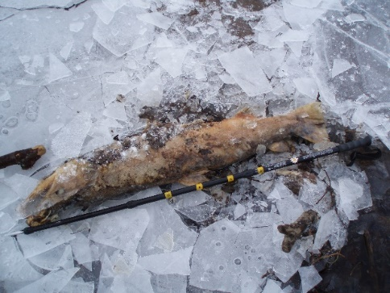
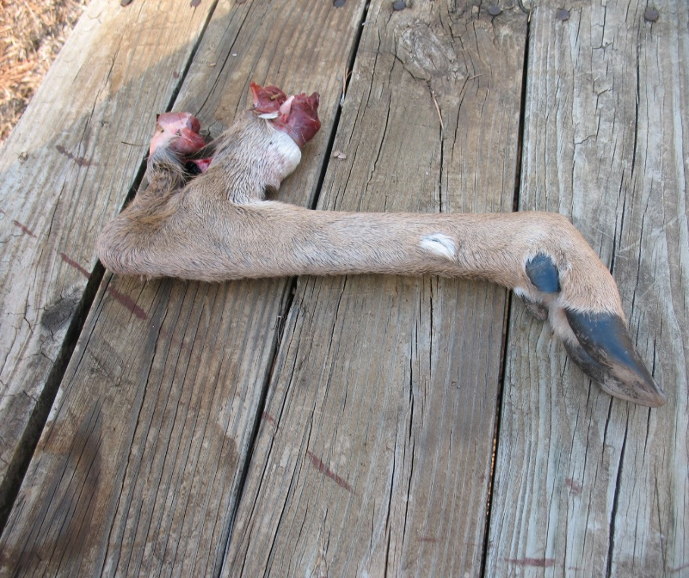
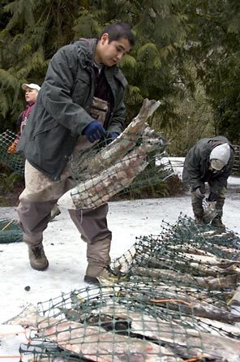
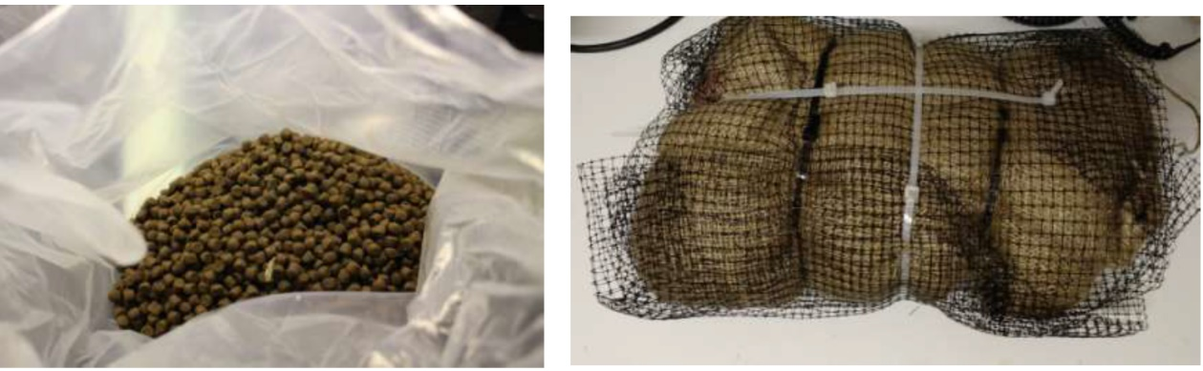
Habitat Restoration - Nutrient Enhancement
Loss of large numbers of dead kelts to nursery areas.
Developing a nutrient enhancement trial.
15 site trial on River Muick
Treated with salmon carcass analogues/ Deer.
Previous trials show doubling of salmon biomass.
Potential to boost quantity and quality of smolts.
Fisheries Protection - Development

Slide 20
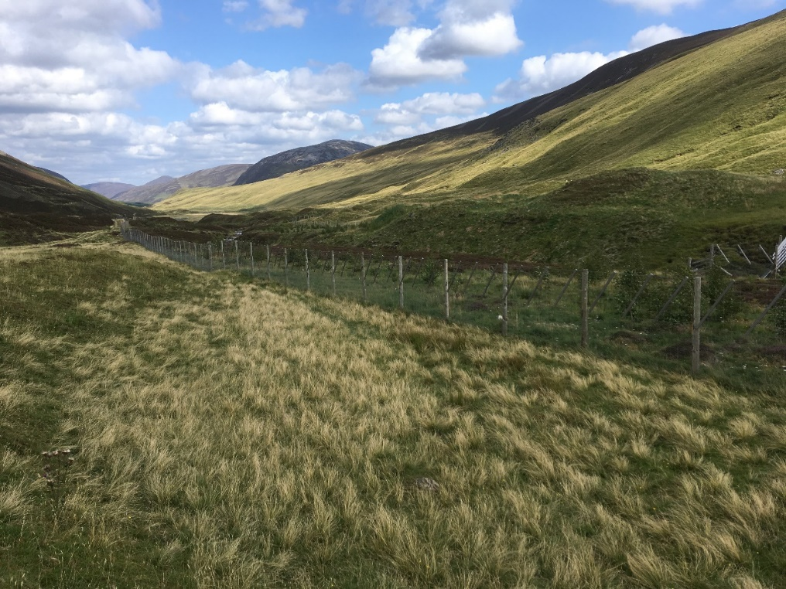
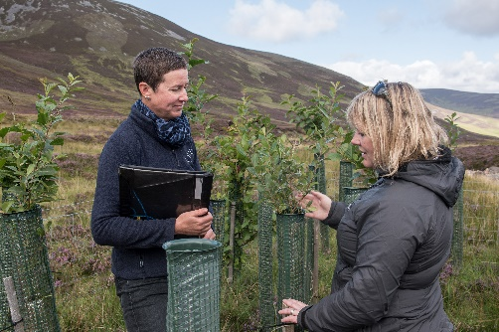
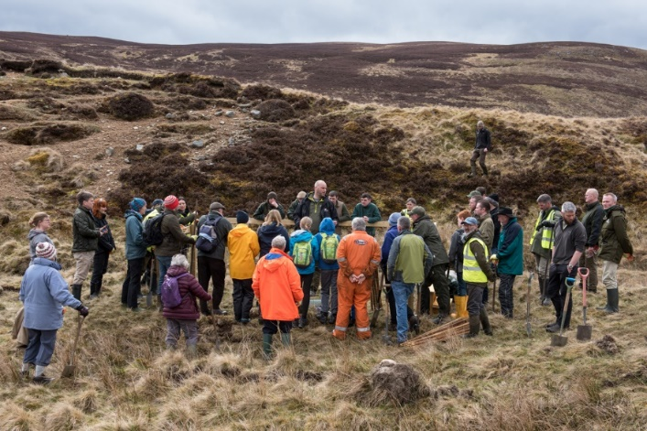
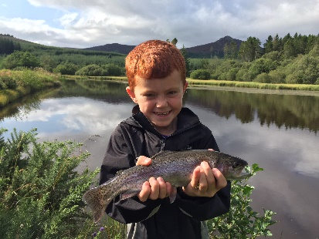
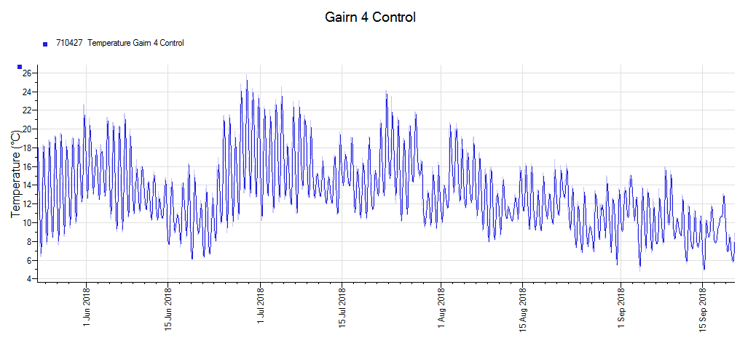
Habitat Restoration – Riparian Woodland
Planting trees is one of the best tools to restore salmon habitat.
Trees stabilise banks, provide food,
create LWS, and most importantly they
provide shade and buffer temperature.
Work within existing land use.
Upper tributaries water temperatures 27.5⁰c (81.5⁰F).
Ensure that future generations enjoy our sport - plant trees!

Slide 21
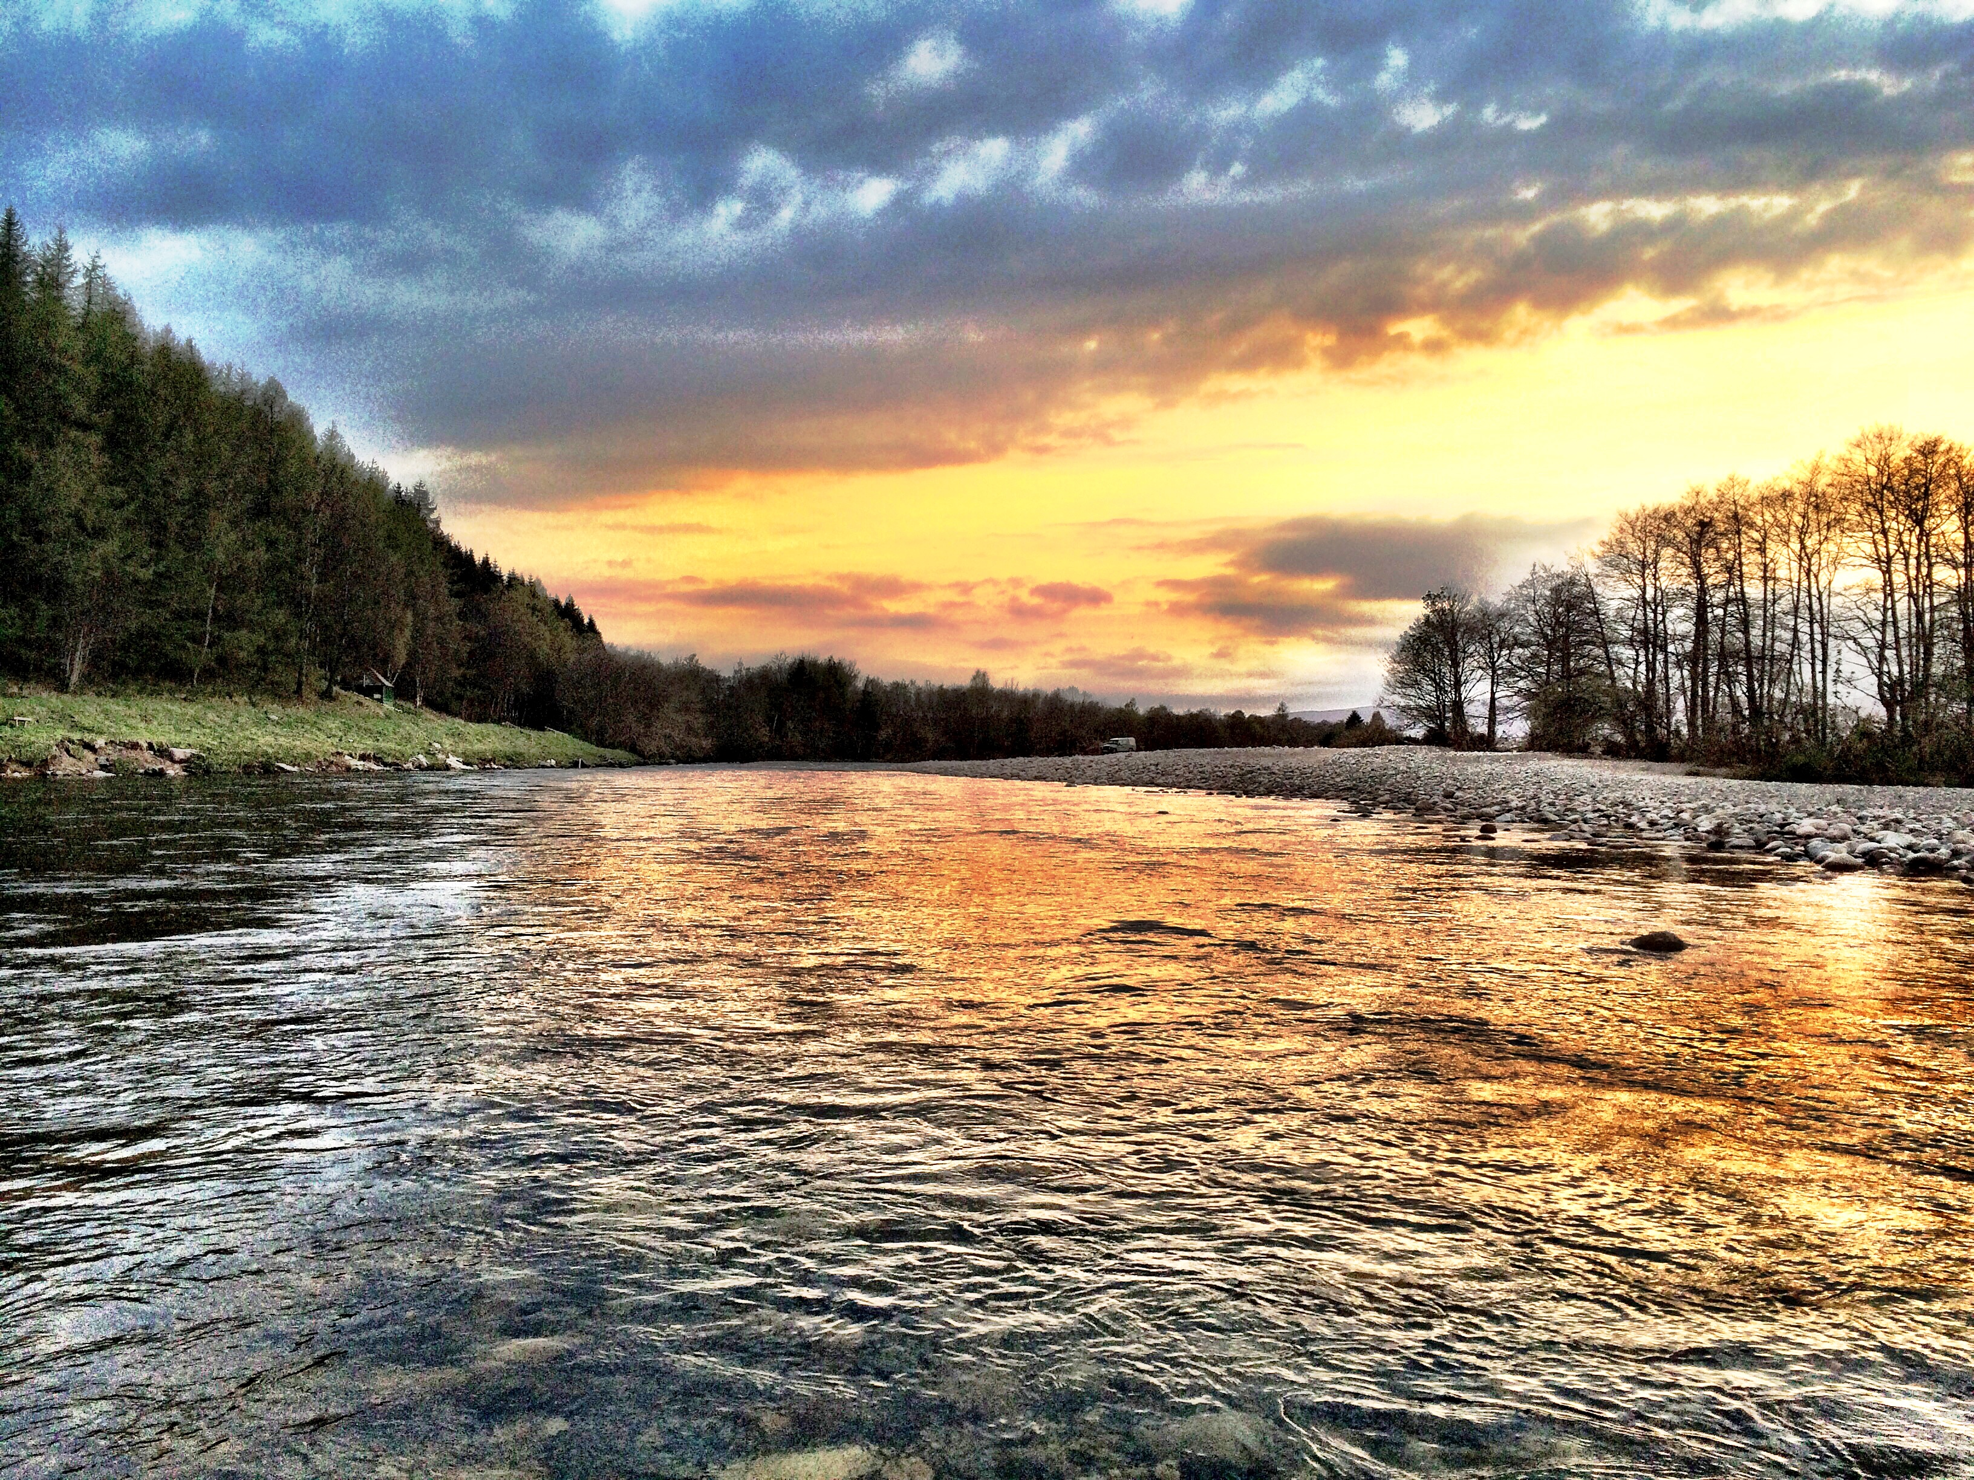
Contact us
River Office, Mill of Dinnet, Aboyne AB34 5LA
Info@riverdee.org
013398 80411

